Slide 1
PHARMA CLASSIFICATION

Slide 2
PROBLEM STATEMENT
The company aims to create a classification model to predict liver disease diagnoses using patient data, categorizing health conditions into five outcomes: No disease, Suspect disease, Hepatitis C, Fibrosis, or Cirrhosis.
The objective is to:
Build a predictive model using various blood and urine measurements (e.g., albumin, alkaline phosphatase, cholesterol, bilirubin).
Ensure high accuracy and reliability in identifying early signs of liver disease.
Deploy the model via Streamlit for clinical usage by medical professionals.
Key Metrics
Predictive accuracy: The model should achieve a high classification accuracy for all five categories of liver disease.
Punctual finishing: The project should be completed, with key milestones such as EDA, model building, evaluation, and deployment.
Constraints:
The data includes some complexity, such as varying normal ranges of medical measurements depending on age and sex.
The model should be interpretable for use by medical professionals who may not be familiar with the technical aspects of machine learning.
By successfully developing and deploying this predictive model, the organization aims to improve early detection of liver disease and enhance patient care.

Slide 3
BUSINESS ANALYSIS
Business Objective: The project aims to predict liver disease in patients based on medical data. The data includes various blood and urine measurements, and the target variable is the diagnosis of liver disease, categorized as one of the following:
->No disease ->Suspect disease ->Hepatitis C ->Fibrosis
->Cirrhosis
Business Context:
Liver disease can lead to serious health problems and increased treatment costs if not detected early. A healthcare institution plans to use data science to develop a classification model that predicts liver disease from patient medical data, helping clinicians with early diagnosis and personalized treatment.
Data Overview:
The dataset contains 615 instances (rows) and 13 variables (columns).
Input Variables: Mostly numerical, including blood and urine measurements such as albumin, cholesterol, bilirubin, etc. One categorical variable is included: sex (binary: "f" or "m").
Target Variable: Diagnosis of liver disease, categorized into five classes (No disease, Suspect disease, Hepatitis C, Fibrosis, Cirrhosis).
Business Value: Predicting liver disease early can:
Improve patient care by initiating treatment sooner.
Lower healthcare costs associated with late-stage liver diseases.
Deploying the model in a streamlit app will provide medical professionals with a simple tool for patient screening and disease prediction, enhancing operational efficiency in diagnostics.

Slide 4
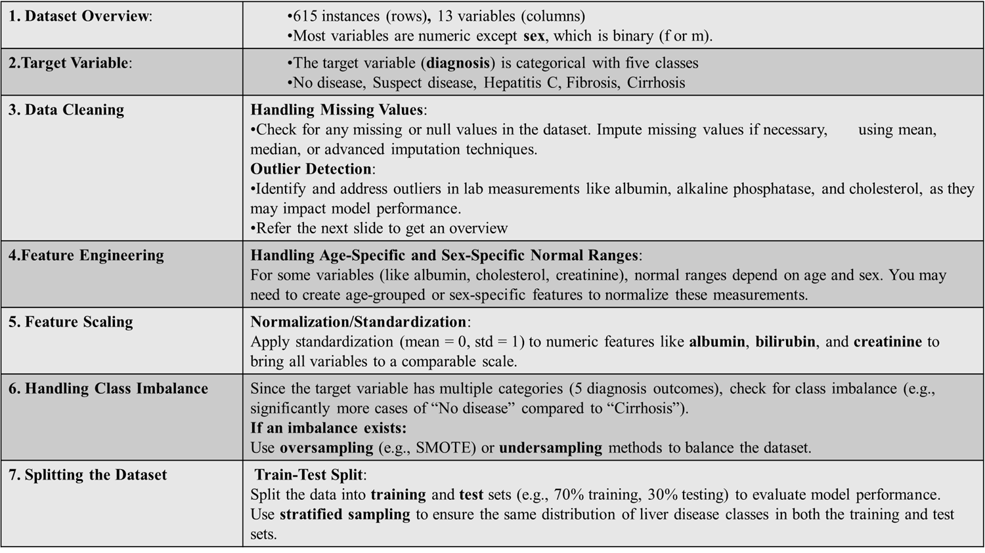
EDA-Exploratory Data

Slide 5
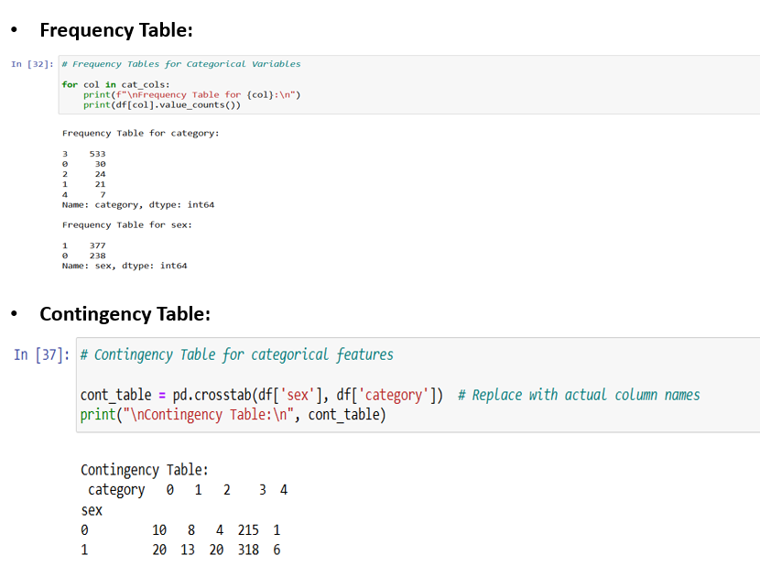

Slide 6
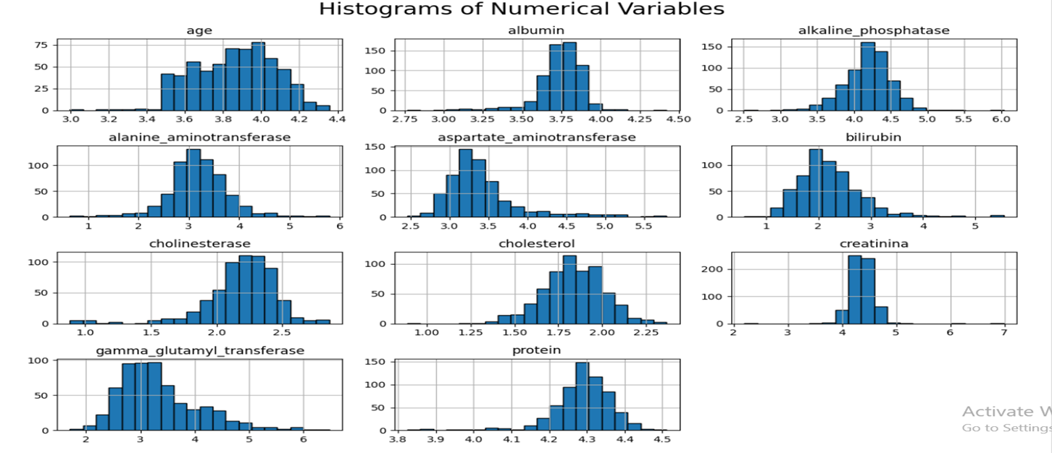
Numeric Variables: Most Numeric variables follow a skewed distribution (Positive and Negative), as observed in the histograms and box plots.
Categorical Variables: The Majority of samples fall into category 3, indicating a potential class imbalance.

Slide 7
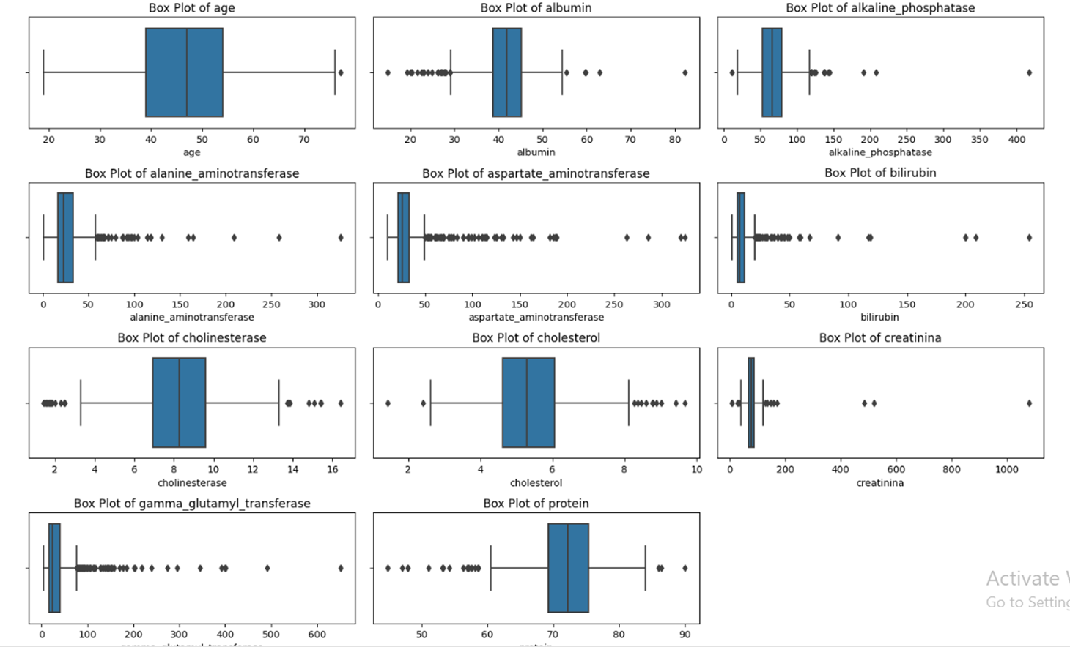
Outliers: Many of the features have significant outliers. For instance, “alanine_aminotransferase”, “aspartate_aminotransferace”, “bilirubin”, “gamma_glutamyl_transferase” and “creatinina” all show extreme values outside the normal range, indicating that some individuals have much higher readings
Outliers presence: The presence of many outliers in certain features may impact the model’s performance, suggesting a need for data pre-processing steps like removal or scaling.

Slide 8
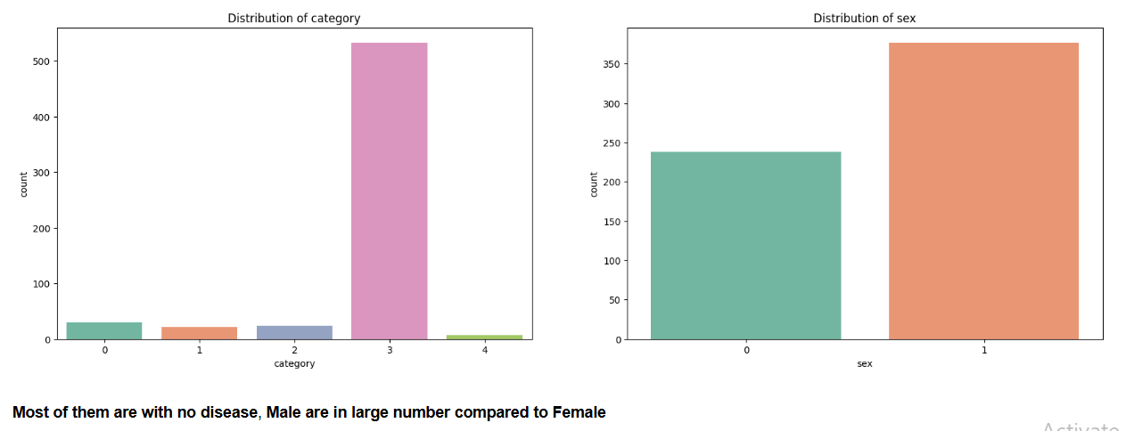
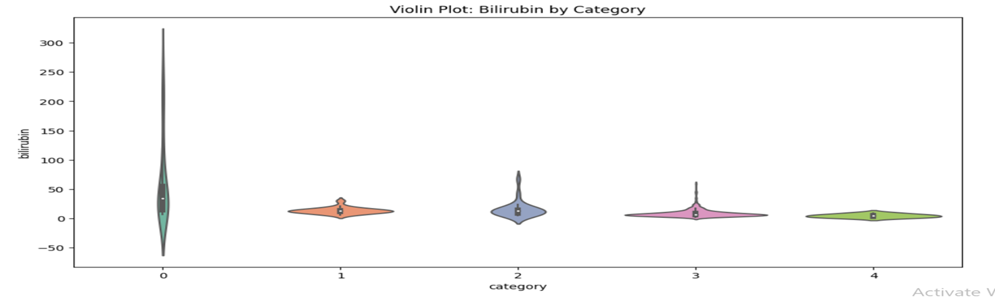
Bar Plots
Violin Plots

Slide 9
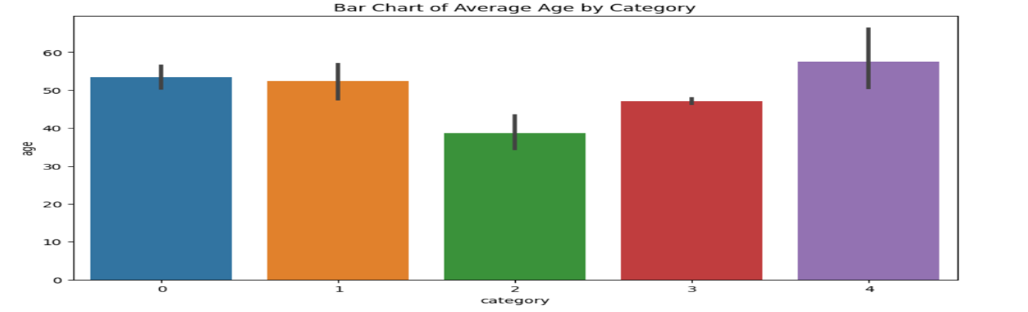
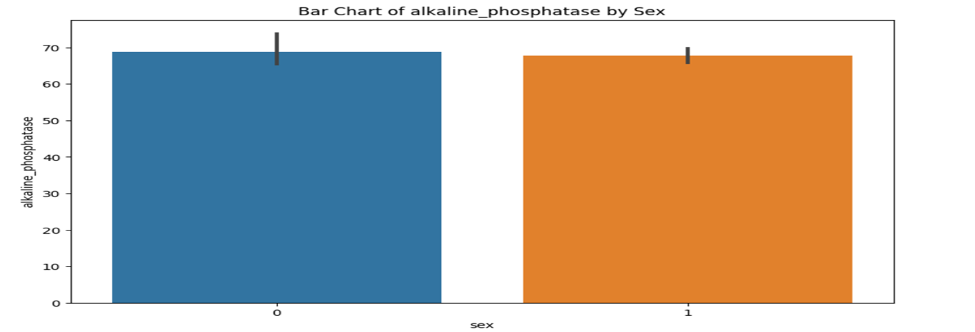
Bar Plots (with Grouping):

Slide 10
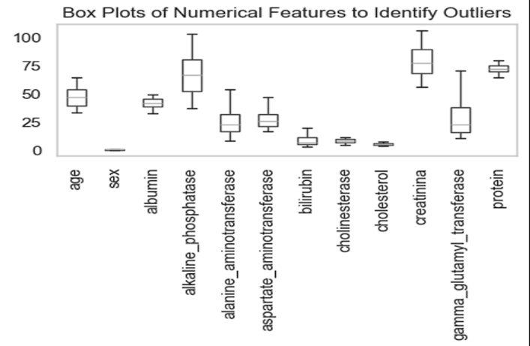
AFTER TREATING OUTLIERS:
The box plots display the distribution of numerical features after outlier treatment, showing controlled variability.
And the absence of extreme outliers, indicating successful adjustments while preserving data integrity.

Slide 11
Model Building
Algorithms
Logistic Regression
SVM
Decision Tree
XGBOOST
Random Forest
Data split:
Training set 80% and testing set 20%

Slide 12
Model Training & Test Accuracy
Model Training Accuracy Testing Accuracy
Logistic 97.45 89.83
SVM 98.72 93.22
Decision Tree 100.0 89.0
XGBOOST 100.0 91.0
Random Forest 100.0 90.0

Slide 13
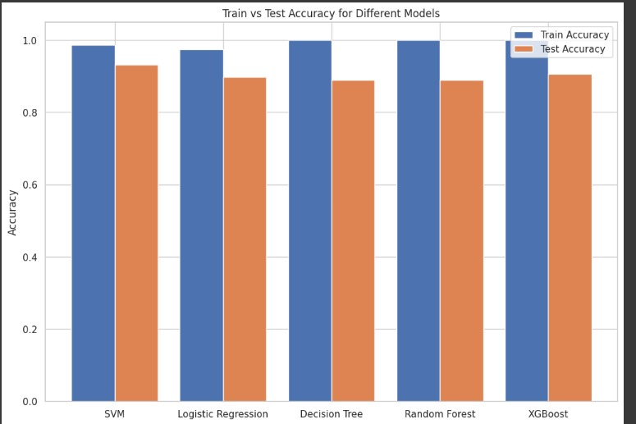

Slide 14
Model Evaluation and Comparison
Accuracy Performance: The graph compares the accuracy of Logistic Regression, SVM, Naive Bayes, XGBOOST, and Random Forest, with XGBOOST achieving the highest accuracy.
XGBOOST Superiority: XGBOOST stands out due to its ability to handle complex relationships in the data, outperforming other models.
Robustness of XGBOOST: It excels at managing outliers, missing values, and large datasets, leveraging gradient boosting for better predictions.
Model Selection : XGBOOST was finalized for deployment based on its superior accuracy and overall reliability.
Evaluation Metrics: While accuracy guided the selection, other metrics (e.g., precision, recall, and AUC-ROC) can provide additional validation for specific scenarios.

Slide 15
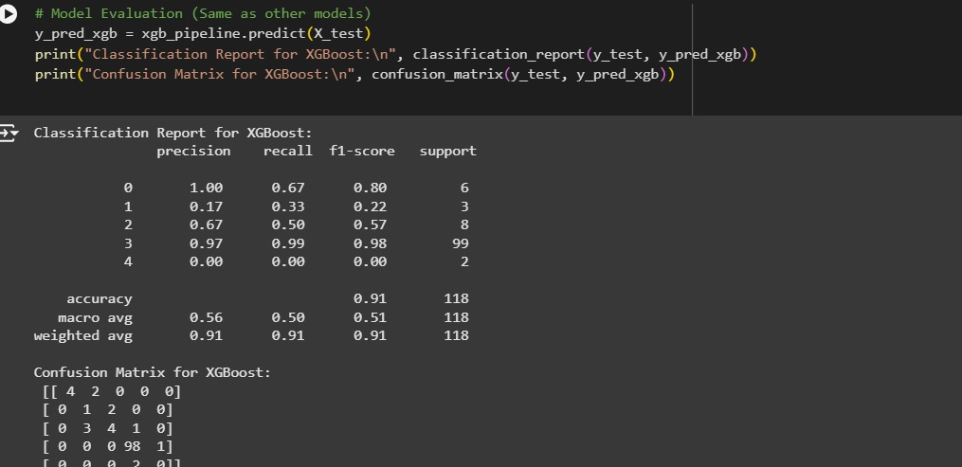
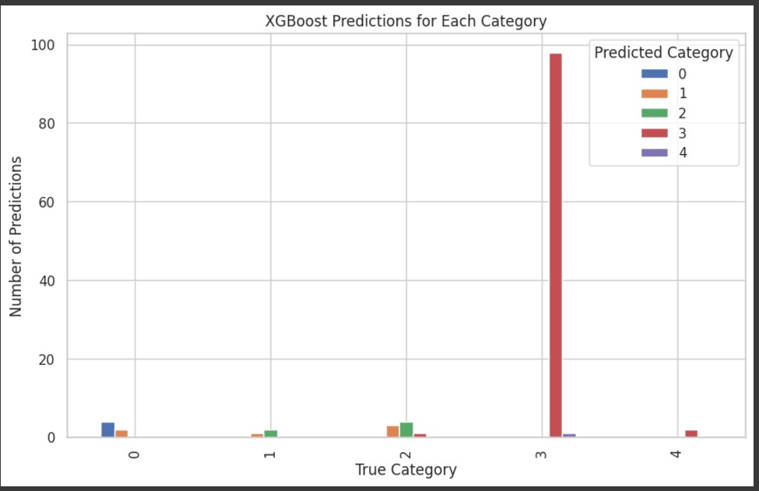

Slide 16
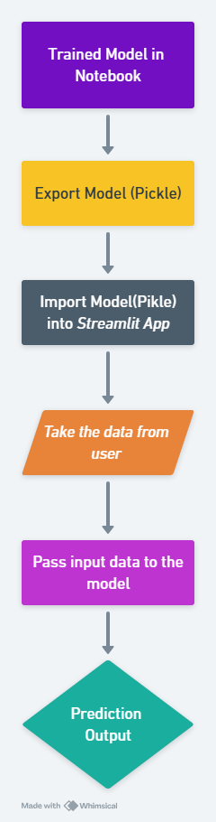
Integrating the Model into Streamlit
Step 1: Training the Model
First, we trained the liver disease prediction model in a Jupyter notebook using medical data.
Step 2: Saving the Model
After the model was trained, we saved it as a file using a method called Pickle.
This allows us to store the model so it can be reused later, without needing to retrain it every time."
Step 3: Deploying with Streamlit
Once the model was saved, we created a simple Streamlit app. In the app, we loaded the Pickle
file and made it ready to take user inputs and provide predictions in real-time.
Step 4: User Interaction
When users upload their liver test data, the app uses the pre-trained model to predict whether
the user might have a liver disease.

Slide 17
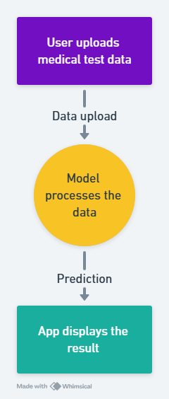
How the Streamlit Application Works
Users visit the Streamlit app
They enter their test data in an easy-to-use form.
The model processes the data in real-time and predicts the
likelihood of liver disease.
The results are shown instantly with the different category
of the liver disease.

Slide 18
Model Deployment
We’ve developed a machine learning model to predict liver disease based on user data using a streamlit.
Users can input their medical test results into the application and get immediate predictions.
The tool helps users understand whether they are at risk of liver disease, helping with early detection and decision-making.
Model deployment involves saving the trained model (e.g., using Pickle or Joblib), creating APIs (using frameworks like Flask or FastAPI), and setting up an environment for real-time predictions.
Model deployment also includes testing the system rigorously with real-world data to ensure the model’s predictions are accurate and reliable before going live.

Slide 19
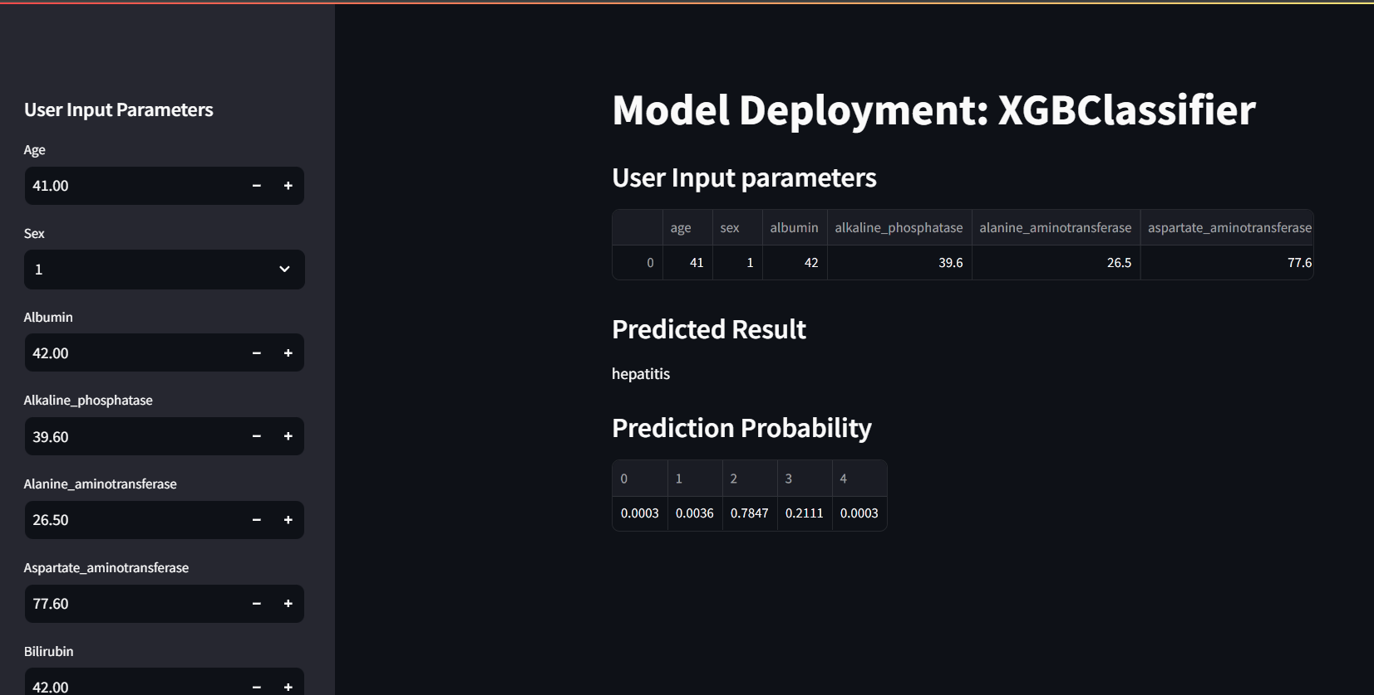
The Output after deploying the model into streamlit.
Here the output is Hepatitis and similarly we have predicted probability of other categories also.

Slide 20
Conclusion
In this data science project, we developed a classification model, analyzed to derive insights and build a predictive model to classify the data. Our work involved EDA, Visualization techniques, Model building, model evaluation and deployment.
Through this process, we gained a deeper understanding of the data's characteristics and the factors most influential to the outcomes.
After extensive data preprocessing, including handling missing values, normalizing features, and performing feature engineering, we explored various machine learning algorithms such as logistic regression, random forest, and support vector machine(SVM), XG Boost, KNN, and Naive Bayes. Based on the analysis, the best-performing model is XGBOOST, emerged as the most accurate one, achieving a training accuracy of 1.0 & testing accuracy of 0.93459.

Slide 21
Challenges Faced While Working and How We Overcame Them
PREPROCESSING:
After loading the dataset, we saw it wasn’t properly separated—everything was comma-separated. we used a delimiter to split the columns correctly.
df = pd.read_csv('project-data.csv', delimiter=';')
There were some outliers, so we addressed them using percentile capping and the Interquartile Range (IQR).
capped_df = cap_outliers(df_cleaned.copy(), numerical_features)
ENCODING :
There were missing values, which we filled with mean values. For categorical features, we used label encoding to convert them into numerical form.
df_encoded[col].fillna(mean_value,inplace=True)
df['category_encoded'] = label_encoder.fit_transform(df['category'])

Slide 22
MODEL BUILDING:
We built several models, like Logistic Regression, Decision Tree, Random Forest, SVM, and XGBOOST. After evaluating accuracy, precision, recall, and F1 score, we finalized the XGBOOST classifier as it showed the best accuracy among all the models.
DEPLOYMENT:
While deploying the model, we encountered data imbalance, so we balanced the data first.
We also scaled the data using Standard Scaler, as it was predicting incorrect categories. Scaling helped resolve this issue.

